Slide 1


Flipkart Customer Retention and CSAT SuggestedAnalysis
This presentation analyzes customer retention and CSAT metrics to identify key drivers and areas for improvement. We will examine state level performance, sentiment trends, and channel effectiveness to provide actionable recommendations for Flipkart.

Slide 2

Customer Retention
Customer Lifetime Value
Customer service
CSAT
Customer Churn Rate
Pricing and value
AVG order value
Response Time
Sentiments
Customer Service Exp.
Customer Retention Rate
Number of customers in Que
Number of Positive Response
Number of Negative Response
Repeat Purchase Rate
Lost Customer
Avg. Purchase Frequency
CSAT

Slide 3
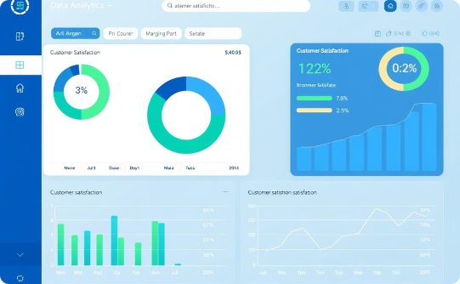


CSAT Metrics Analysis
Service Quality Insights
Retention Strategies
Comprehensive evaluation of customer satisfaction scores across different channels and states
Identifying performance drivers and improvement opportunities in customer support channels
Developing targeted approaches to enhance customer loyalty and long-term engagement
Customer retention column created on the bcais of CSAt score like if csat score is more than or equal to 5 than the customer is retained .
Response time colunm creted on the basis of call duration in min.(if call duration is <=5, "Short", <=30, "Medium", "Long")).
Location colunmn created on the basis of call center loaction (Mumbai= 1,Delhi= 2,Kolkta= 3, Chennai= 4).

Slide 4

Customer Retention Status Analysis
Retention Status
Key Retention Metrics
The percentage of retained customers is significantly higher than those not retained. This indicates a solid base but also highlights the need to address churn.
Fast response times correlate with high retention.
High CSAT scores contribute to customer loyalty.
Positive sentiment drives long-term engagement.

Slide 5
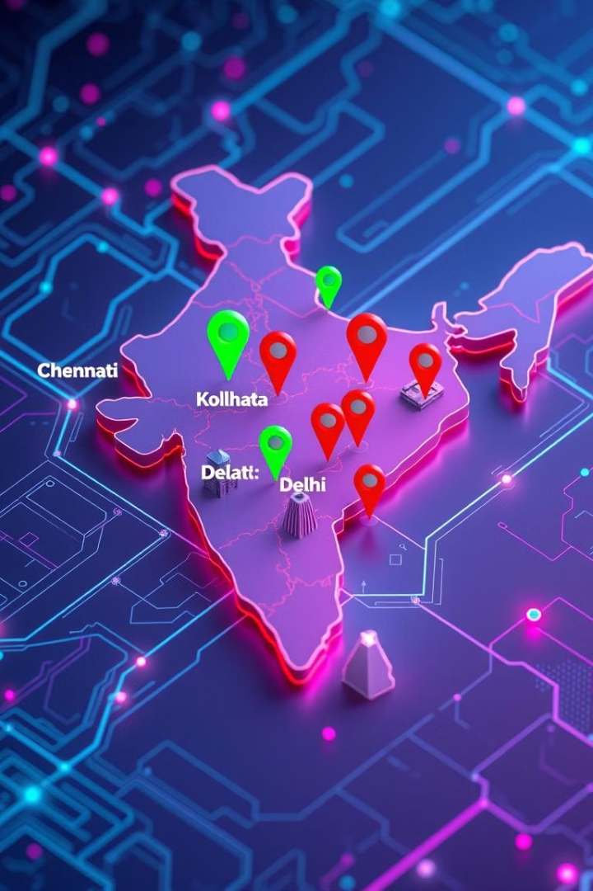




State-Wise CSAT Analysis
Chennai & Delhi
Higher CSAT scores indicate effective call center operations.
Kolkata & Mumbai
Lower CSAT scores suggest service quality or expectation issues.
Insight
Regional differences in CSAT scores need a targeted approach.
High CSAT States
Arunachal Pradesh
Puducherry
Sikkim
Uttarakhand

Slide 6

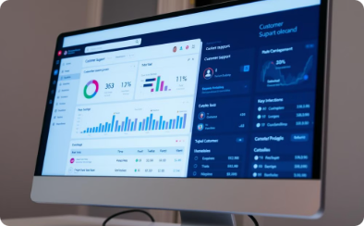


Support Channel Impact On CSAT
Call Center Channel
Web Channel
Chatbot Channel
Email Channel
Highest satisfaction score of 5.6, providing excellent customer experience for payment-related queries.
Matches call center with a 5.6 satisfaction score, offering seamless online customer interactions.
Lowest satisfaction at 5.4, suggesting potential improvements needed in automated response systems.
Email Support (CSAT 5.4) shows relatively low customer satisfaction, indicating potential delays or inefficiencies in response time.

Slide 7
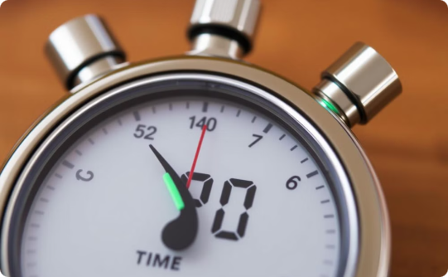
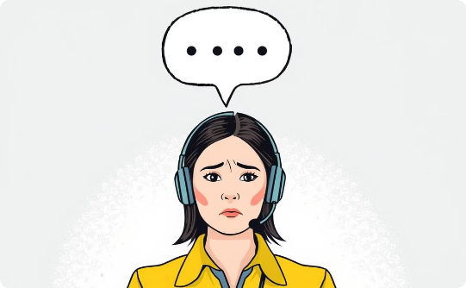
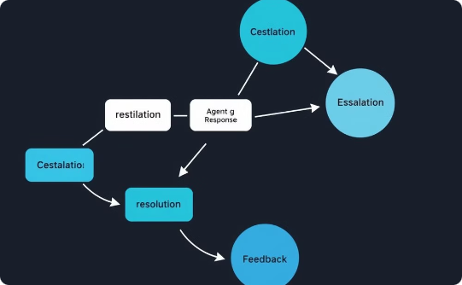
Call Handling Time Insights
Majority of Calls Within SLA
Calls Below SLA
Above SLA Calls
Most calls have a duration within established service level agreement limits.
Calls not meeting SLA tend to have significantly shorter durations, potentially indicating unresolved issues.
Calls exceeding SLA time limits could signal complex queries or inefficient handling processes.

Slide 8



Customer Pain Points
Billing Issues Have the Lowest CSAT (5.25)
Payments Issues (CSAT 5.80)
Service-Related Issues Have the Highest CSAT (6.86)
Payment-related queries have a slightly better satisfaction score than billing issues but still indicate some level of dissatisfaction. Delays in refunds, transaction failures, or incorrect charges could be contributing factors.
Billing and payment-related queries have the lowest CSAT scores (5.53 - 5.63), indicating customer dissatisfaction in these areas. This indicates a major pain point that requires improvement in clarity, transparency, and faster resolution.
Customers reporting service outages or general service concerns seem to have the best experience among the listed issues. This suggests that resolution times and customer support in this area are more effective.

Slide 9



Gender Influence on CSAT
Male Customers: Slightly Higher CSAT
Female Customers: Nuanced Experiences
Balanced Customer Demographics
Male customers report a marginally better satisfaction score of 5.55, suggesting subtle differences in service perception.
Female customers show a CSAT score of 5.48, indicating potential variations in service expectations between genders.
Nearly equal gender distribution: 50.3% male and 49.7% female respondents, ensuring representative insights.

Slide 10




Satisfaction Levels Across Sentiments
Very Positive Sentiment (9.1)
Positive Sentiment (8.0)
Neutral Sentiment (6.5)
Negative Sentiment (4.4) & Very Negative Sentiment (2.8)
A good number of customers were satisfied but not overwhelmingly happy
Some customers neither loved nor disliked their experience, showing room for improvement.
Customers who had an excellent experience rated their satisfaction the highest
Customers with a poor experience scored low, highlighting service gaps. The lowest satisfaction level indicates a serious issue with these interactions, likely caused by unresolved complaints or poor service quality.

Slide 11
Recommendations and Next Steps
Address Regional Gaps
Improve Retention
Focus on improving CSAT in Kolkata and Mumbai by addressing call center issues.
Investigate reasons for customer churn; male and female retention are similar.
Target High-Value States
Enhance Web Channel
Personalize offers and loyalty programs for top contributing states.
Focus on web for service outage communications. Improve chatbot AI to assist clients better.

